Slide 1
Automated Data Transfer from Multiple Databases to AWS S3 and RDS
Monica M
Suriya V
Dinesh S

Slide 2
Abstract
This project that aims to simplify and automate the process of transferring data from different databases to AWS S3 and RDS. The project utilizes AWS CLI to extract data from the source databases and load it into the target S3 bucket, and then uses AWS Lambda to read the data from S3 and load it into RDS. The AWS CLI and Lambda are both serverless services that can handle large amounts of data and can scale up or down automatically based on the workload. The benefits of automatically transferring data from different databases to S3 and RDS include improved efficiency, scalability, and reliability. By centralizing the data in S3 and RDS, organizations can simplify their data management and analysis processes, making it easier to gain insights from their data and make informed decisions.

Slide 3
Existing System
In an existing system that uses Talend for data integration in ETL processes, Talend is typically used to extract data from various sources, transform and validate the data, and then load it into a target data warehouse.
Talend supports a wide variety of data sources and destinations, making it a flexible tool for integrating data from multiple sources and transferring it to multiple targets.
Talend is designed to support high-volume data integration, making it a powerful tool for managing large and complex data integration projects.

Slide 4
Literature Survey
Automated data transfer from multiple databases to AWS S3 and RDS has been widely studied in the literature. Various studies have shown the benefits of using AWS for data storage, transfer, and management. AWS offers a cost-effective and scalable solution for companies of all sizes. Moreover, the use of Lambda and CLI for automated data transfer has been extensively researched and found to be an efficient and reliable method. Additionally, the use of Talend for data integration in ETL, highlighting its benefits such as scalability, flexibility, and a large number of connectors for different types of data sources. The literature survey has also emphasized the importance of choosing the right method for data transfer and integration based on the specific needs of a company, including the size and complexity of data, the frequency of transfer, and the available resources.

Slide 5
Proposed System
In this system data from the different databases will be extracted using the appropriate commands and then transferred to AWS S3 using the AWS CLI.
Once the data is in S3, the Lambda function will be triggered to perform the necessary transformations and transfer the data to AWS RDS.
The Lambda function will be responsible for all the data processing, including data cleaning, transformation, and formatting.
This approach allows for real-time data transfer and eliminates the need for manual intervention in the data transfer process. Overall, the use of CLI and Lambda in this project provides a simple and efficient solution for automating data transfer between different databases and Amazon RDS.

Slide 6
Tools Used
Hardware Requirements:
A machine with cpu,memory.
Software Requirements:
Source database software
AWS CLI
AWS lambda
AWS RDS

Slide 7
Modules
Database Connectivity
Data Extraction
Data Transformation
Lambda function
Data loading
Logging and Monitoring

Slide 8
Status of the Project
As of the current date, we have made significant progress in automating the transfer of data from multiple databases to AWS S3 using CLI. The data was extracted from the database in he required format and stored it in a local folder, then it was automatically pushed to AWS S3 using CLI. The next step is to move the data from S3 to RDS using Lambda which involves python code to automate the process.

Slide 9
Project Guide Meeting Details
S.No | Date | Suggestions from Guide
1. | 09/02/2023 | Suggested to change the topic and be clear in the project.

Slide 10
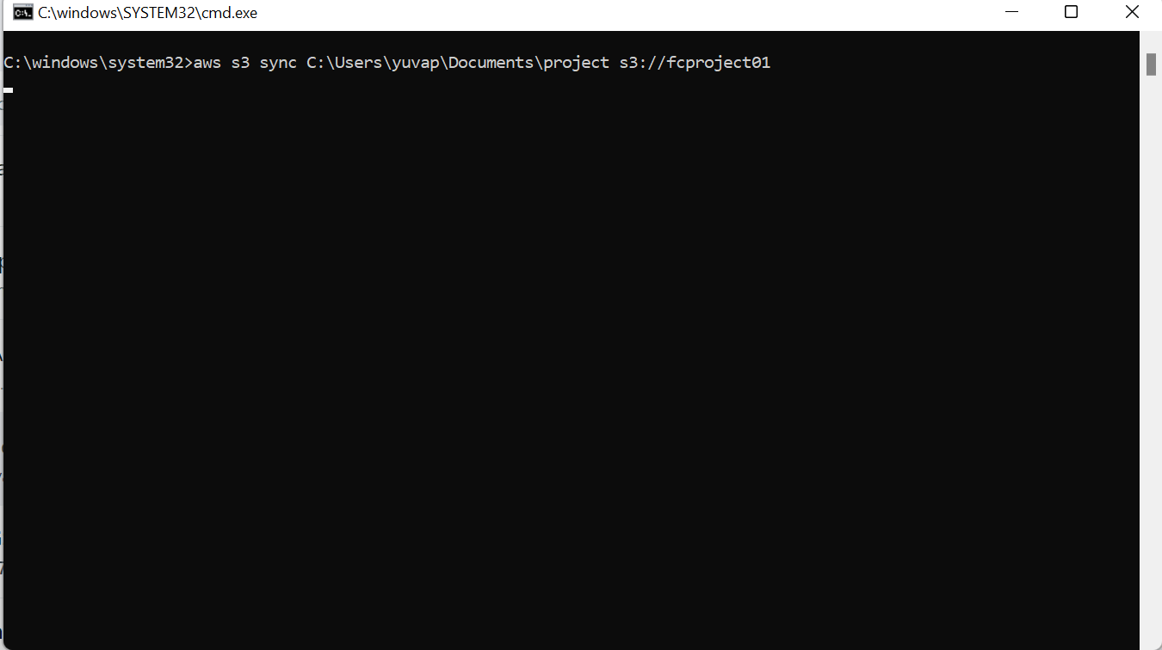
Sample Screen shoots

Slide 11
Github screen shoot

